Slide 1
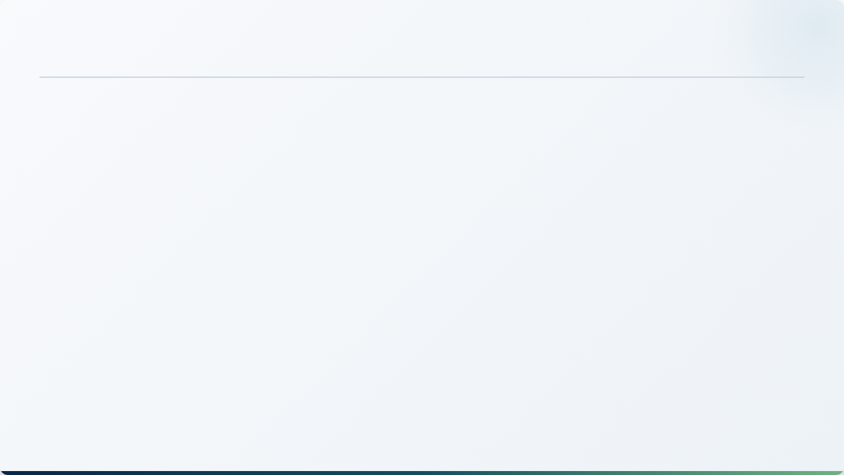

GREATER NOIDA • ESTABLISHED 1993
IILM UNIVERSITY
Internship Assessment Report
Social Media Strategy & Digital Management
A Comprehensive Study on Brand Growth, Content Funnels, and Community Operations
STUDENT NAME
ENROLLMENT NO.
PROGRAM & SEMESTER
HOST ORGANIZATION
Shivansh Srivastav
[Enrollment Number]
B.Tech CSE • Semester V
Fokuszy (Fokuszy.in)

Slide 2

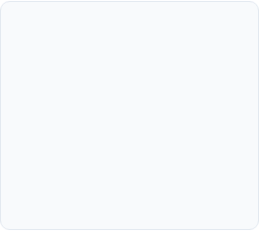
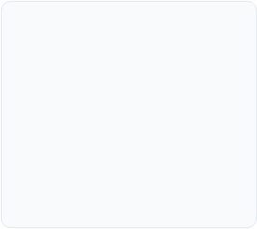
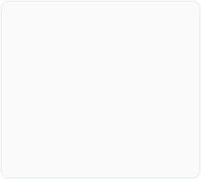
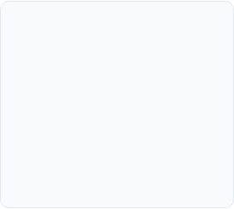



Presentation Agenda
1. Organization Profile
2. Role & Responsibilities
3. Strategy & Execution
4. Impact & Verification
Background of Fokuszy, business objectives, and service ecosystem overview.
Content calendar, visual storytelling, and data-driven engagement funnels.
Scope of duties as Social Media Manager, goals, and daily operational deliverables.
KPI outcomes, key technical learnings, and formal certificate sign-off.

Slide 3
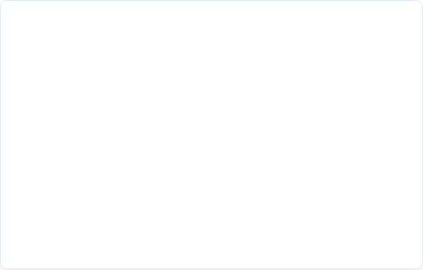

About Host Organization: Fokuszy
Fokuszy (Fokuszy.in) is a dynamic digital branding and media consultancy focused on empowering modern enterprises through targeted online positioning.
•
Core Domain: Content marketing, visual design systems, and digital communication.
•
Mission: Transforming brand narratives into high-converting, engaged digital communities.
•
Work Environment: Collaborative, agile, and iterative remote operations aligned with real-time market trends.
•
Supervision: Guided under executive leadership with regular milestone checks by Kashish Panday (HR) and Manish Bhatt (General Manager).

Slide 4


Internship Objectives & Scope
Strategic Objectives
Operational Scope
Expand Organic Reach: Develop and deploy consistent editorial roadmaps designed to increase brand discoverability across high-intent channels.
Content Pipeline Management: Draft, schedule, and cross-promote monthly content buckets adhering to firm aesthetic standards.
Analytics & Continuous Iteration: Synthesize engagement dashboards to detect top-performing post categories and refine weekly schedules.
Audience Retention: Build interactive hooks, community polls, and discussion threads to convert passive viewers into active community followers.

Slide 5
Key Responsibilities & Deliverables
Content Ideation & Scheduling: Curated weekly content grids including carousels, informative single-image posts, and concise video hooks aligned with brand guidelines.
Copywriting & CTA Framing: Authored conversion-focused captions paired with targeted hashtag research to optimize organic reach and audience actions.
Community Interactivity: Actively monitored inbound comments, mentions, and inquiries to maintain an active, credible social voice.
Cross-Department Coordination: Partnered closely with design leads and senior leadership to align weekly campaign rollouts with strategic firm milestones.

Slide 6
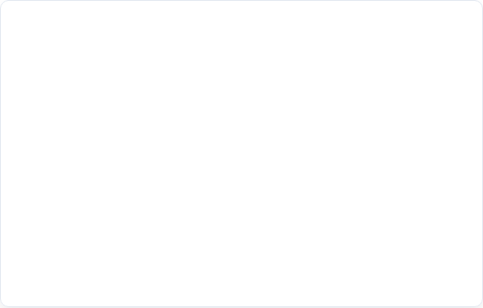
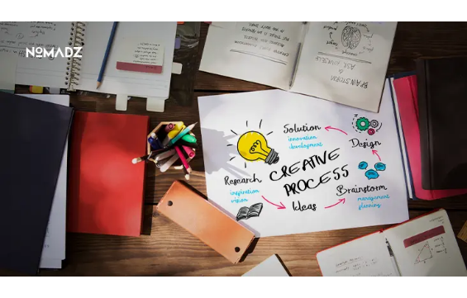
Tools & Software Stack Utilized
Category | Primary Platforms | Application Scope
Asset Design | Canva, Adobe Suite | Post graphics, banners, and typography
Scheduling | Meta Business Suite | Queue management, automated publishing
Data Analytics | Platform Insights | CTR, impressions, reach audit
Organization | Notion, Google Sheets | Editorial calendar & asset archives

Slide 7
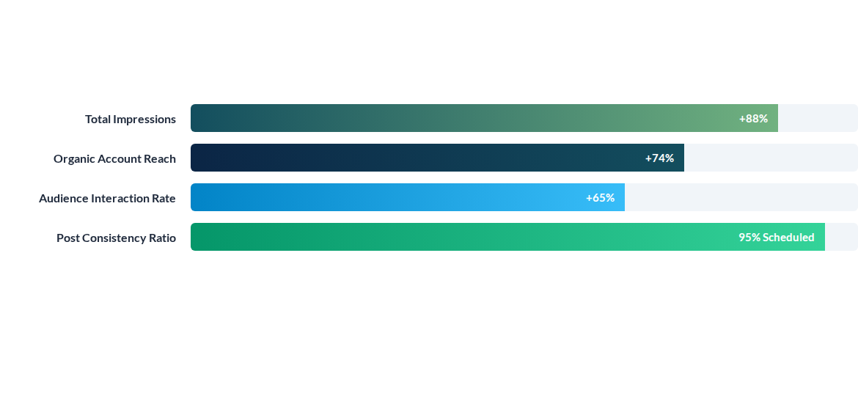
Campaign Performance & Metric Growth
Metrics evaluated across June 15 – July 15, 2026 tenure, indicating consistent performance growth resulting from targeted content themes and improved publishing cadence.

Slide 8
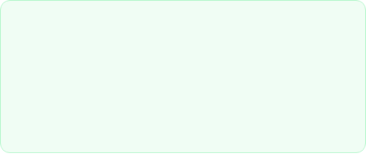
Key Measurable Outcome
Audience Growth Through Structured Campaigns
3.2x
By transitioning from ad-hoc posting to structured content pillars (Industry Insights, Interactive Carousels, and Brand Culture), audience responses improved significantly.
Organic Engagement Lift
The structured calendar allowed Fokuszy to maintain high topical relevance, generating higher organic shares and consistent profile visitation during the internship period.

Slide 9
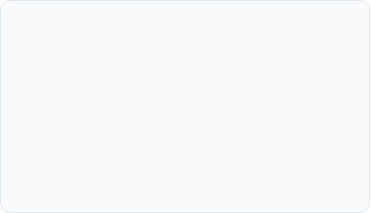
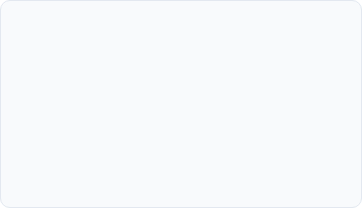
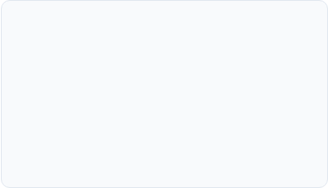



Competencies & Skill Acquisition
Data-Driven Decisions
Brand Voice Framing
Campaign Agility
Evaluating engagement metrics to make evidence-based decisions rather than intuitive guessing.
Crafting tone, syntax, and messaging aligned with the organizational philosophy and goals.
Adapting strategies swiftly in response to trending online narratives and industry shifts.

Slide 10
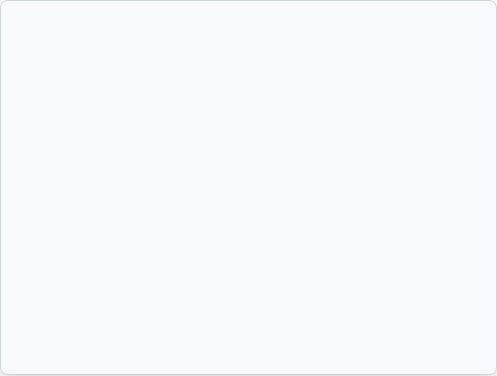
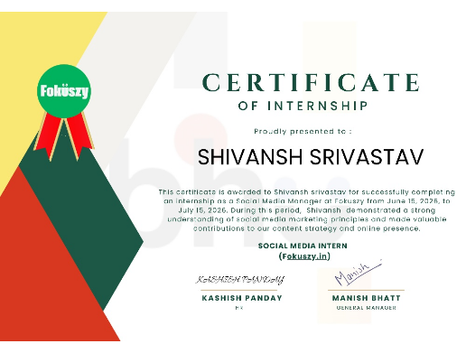
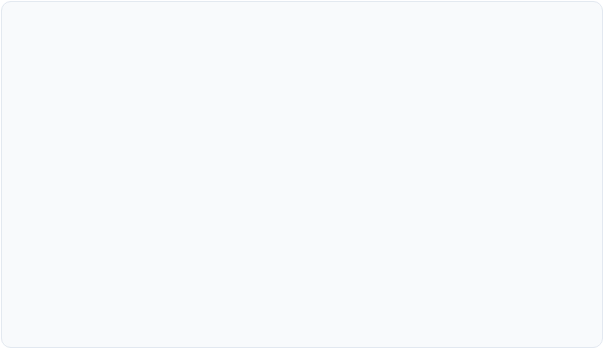
Certificate of Completion
Credentials Summary
Candidate: Shivansh Srivastav
Assigned Role: Social Media Manager / Intern
Issuing Organization: Fokuszy (Fokuszy.in)
Signatories: Kashish Panday (HR) & Manish Bhatt (General Manager)
The original certificate is embedded above as documented evidence of the successful completion of the prescribed internship program.

Slide 11
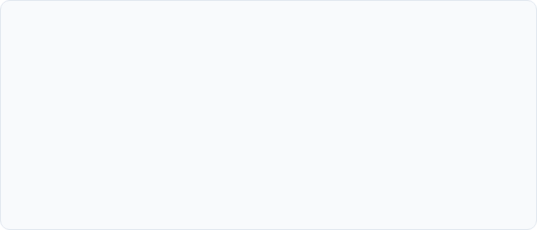

Conclusion & Forward Roadmap
Academic & Career Value
Future Implementation
The tenure at Fokuszy bridged academic theoretical understanding with actual corporate digital management execution.
Applying automated analytics dashboards and programmatic content funnels to future projects.
Direct exposure to content workflows, deadline compliance, and executive evaluations built solid industry readiness.
Leveraging learnings from brand strategy to complement core software engineering and technical design initiatives.

Slide 12
Thank You
I welcome any questions, observations, or feedback from the faculty committee.

Slide 13


Image Sources
https://gtc.co.za/wp-content/uploads/2022/11/team-work-process-marketing-strategy-brainstorming-paperwork-digital-modern-office-1-scaled.jpg
Source: gtc.co.za
https://nomadzdigital.com/blog/wp-content/uploads/2026/03/Best-Content-Creation-Tools-to-Boost-Your-Marketing-Strategy.webp
Source: nomadzdigital.com

